Slide 1
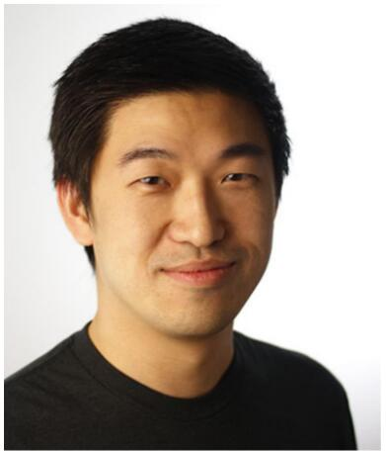
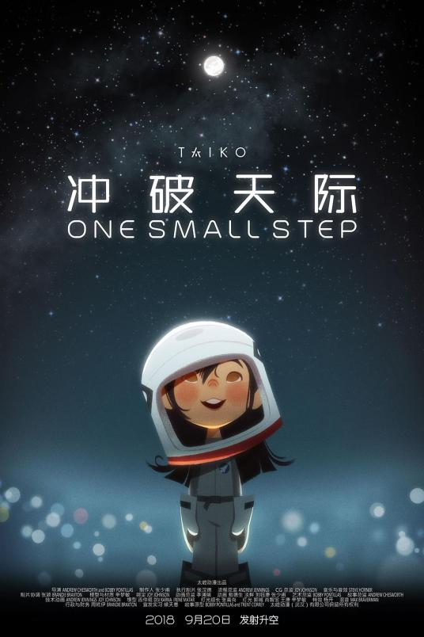
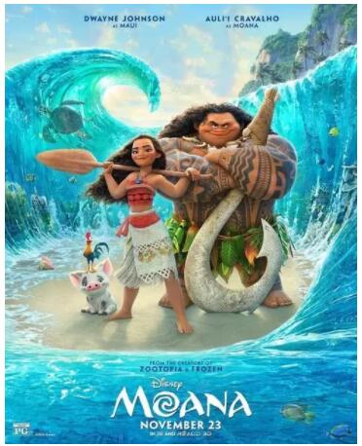
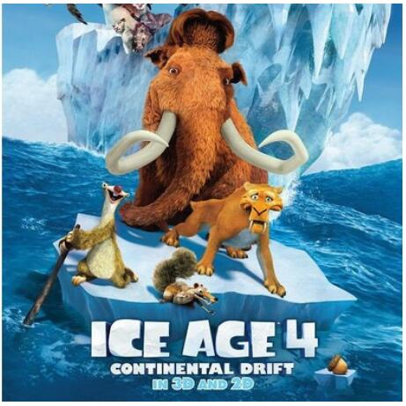
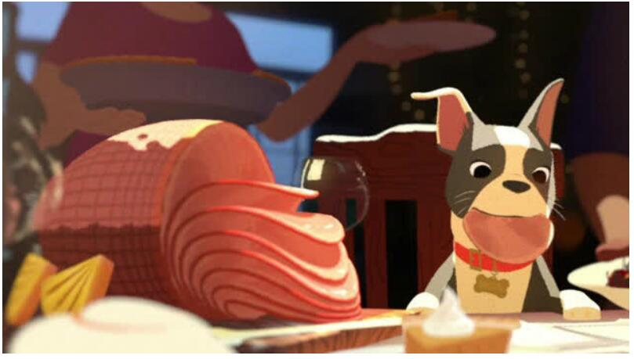
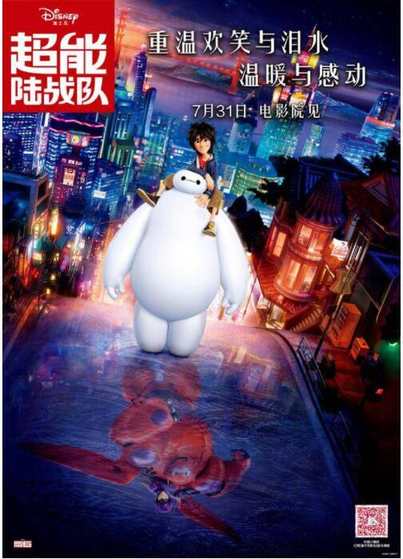
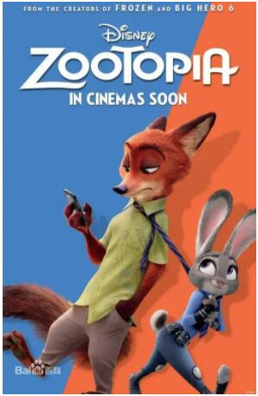
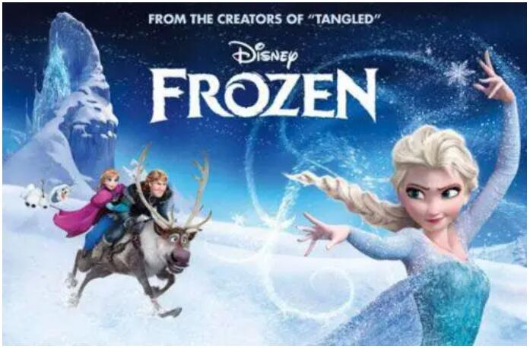
Zhang Shaofu
with his animation
Naduo Wu Group B

Slide 2
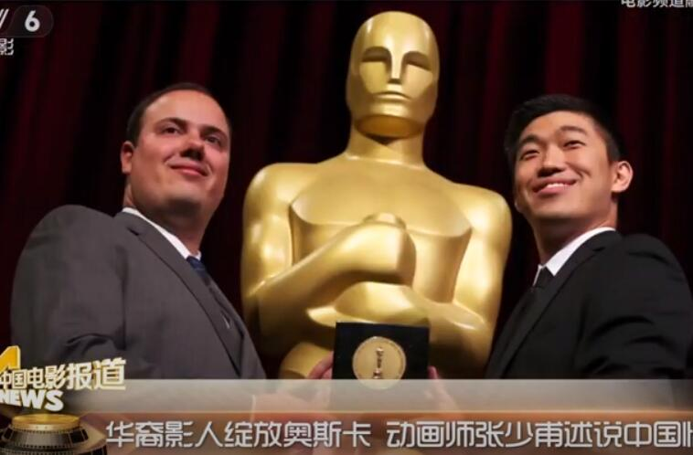
Why am interested in him？
· The first Wuhan person elected as an Oscar judges.
· One of the professional animators in Hollywood.
· As a Wuhan man, I am extremely proud of him.
·I will study his personal experience and his animation.
Because his lot of skills are useful to my future works.

Slide 3
Contents
Personal Experience
About his work
The historical and political connections with his work
What I have learned from him
Sources

Slide 4
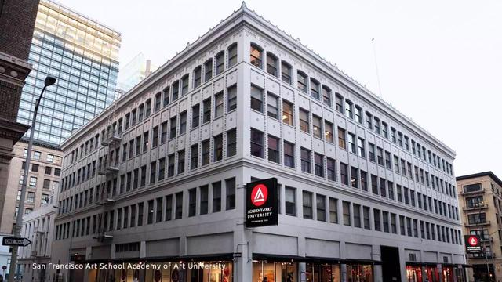
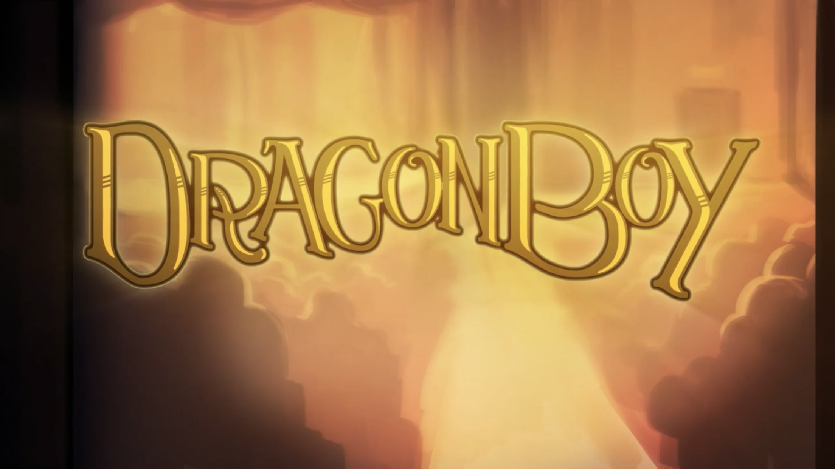
Personal Experience
Zhang Shaofu （1984-2011）
·Born in 1984, Wuhan.
·Settled in the United States at the age of 5.
·San Francisco Academy of Art MA character animation student.
·Become interested in animation in his 26th.
·His animation Dragon Boy
won the 38th Student Academy Awards Animation Gold Medal.

Slide 5
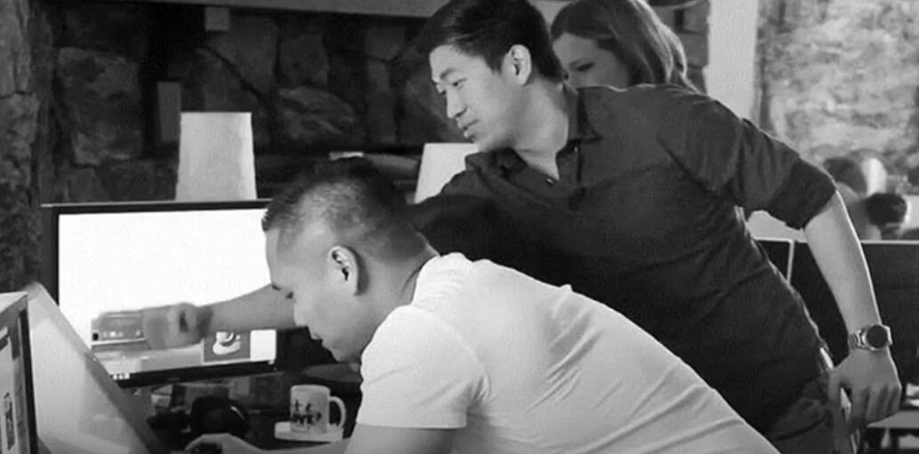
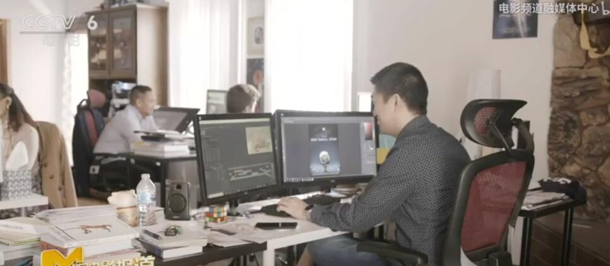
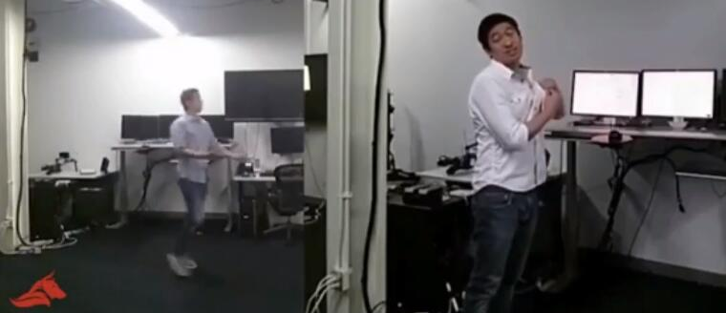
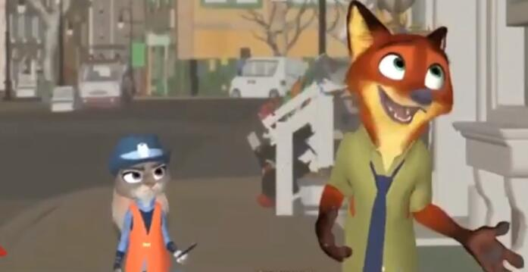
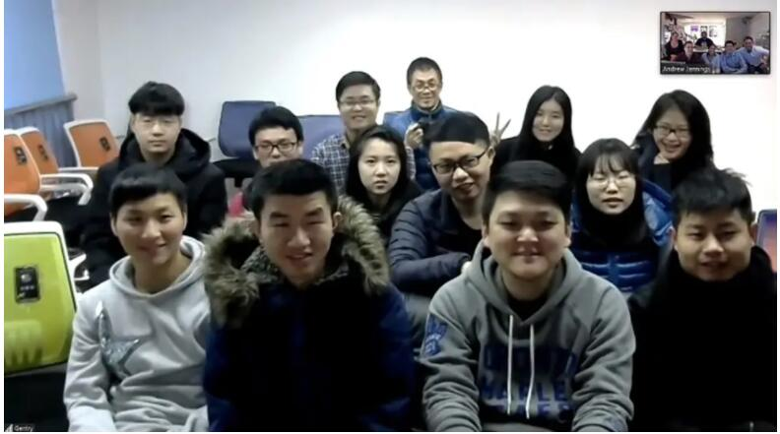
Zhang Shaofu（2011-2018）
·He became a professional animator.
(2011)
·He worked in Sony and Disney company.
·He founded Taikong Stuidios in Guanggu.
(2017).
·He cooperated with famous directors and teams.
·He published the animation One More Step.
(2018, Oscar Nomination)

Slide 6
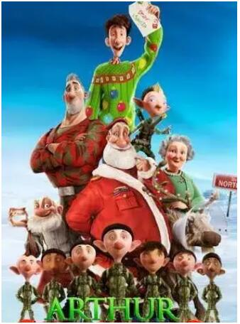
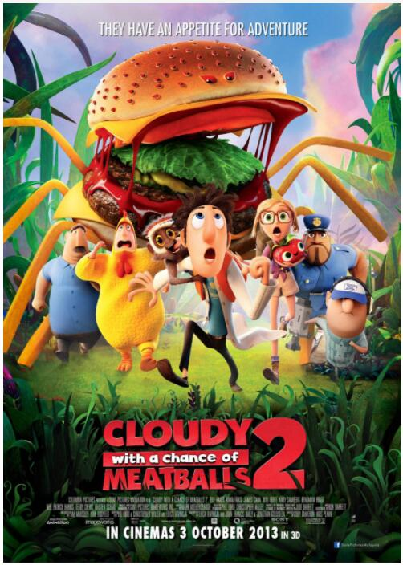
2. About his work
Sony Animation
(2011-2012)
Disney Animation
（2013-2016）
One Small Step
(Wuhan, 2018)

Slide 7
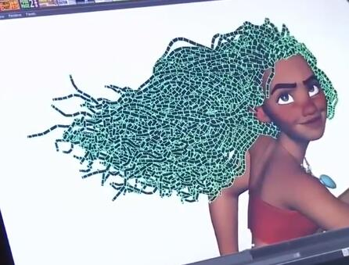
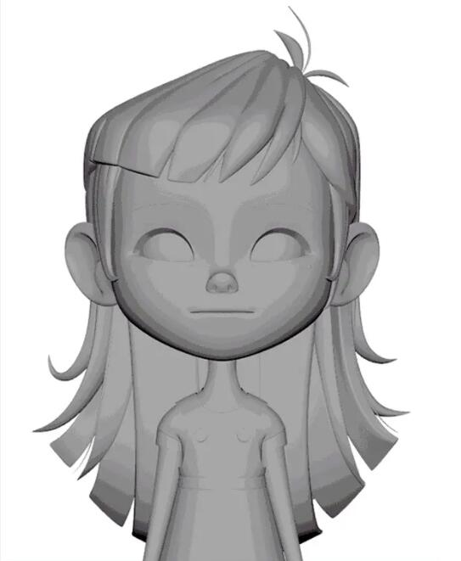
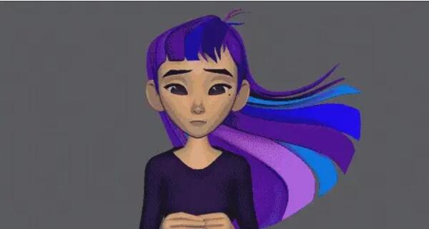
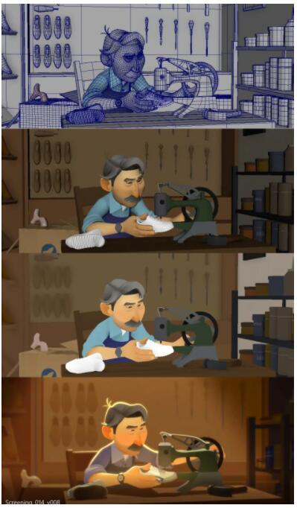
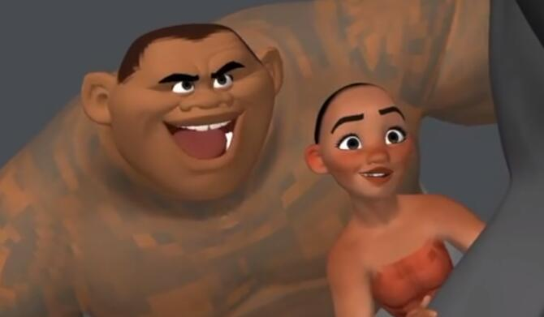
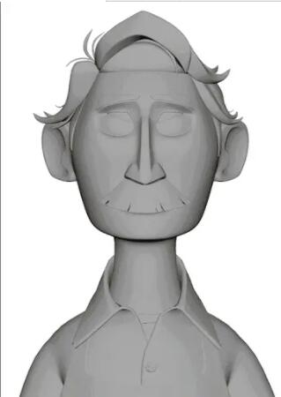
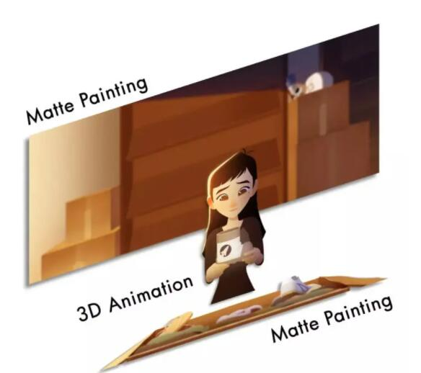
Animation Technics
All 3d software （Maya，Blender，Zbrush）
One Small Step （Ps 3d models to render 2d style）
Simple but not easy：Return to Nature.
The big progress of 2D Chinese Animation.

Slide 8
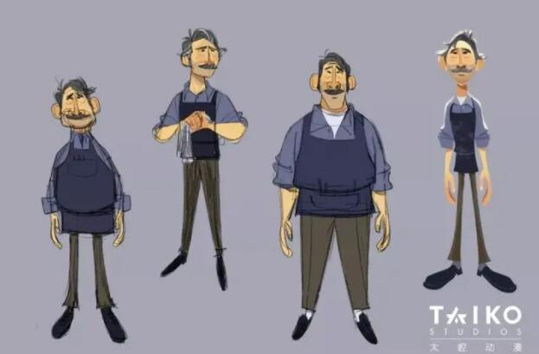
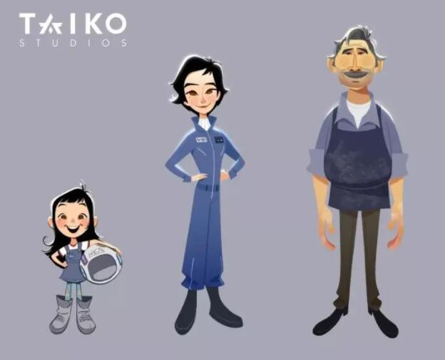
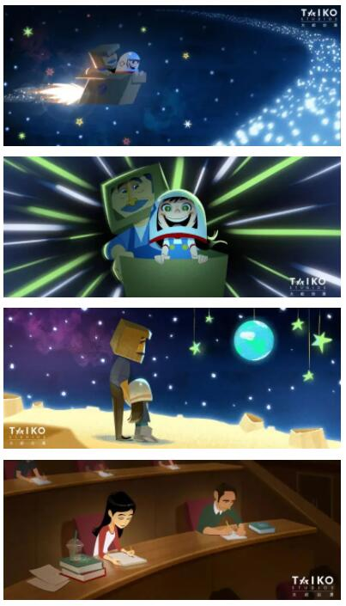
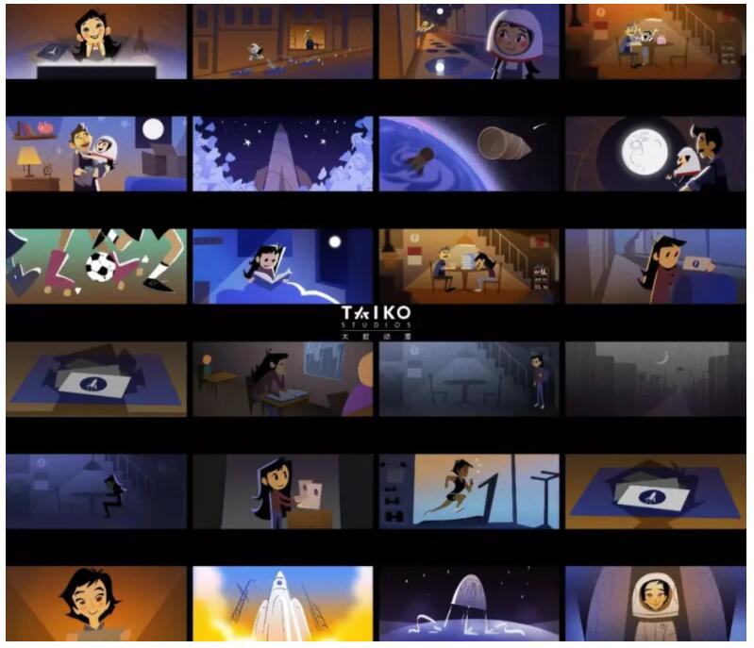
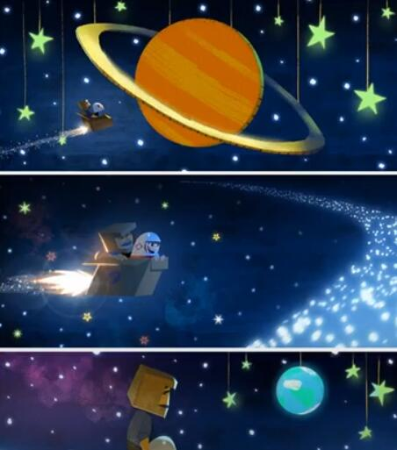
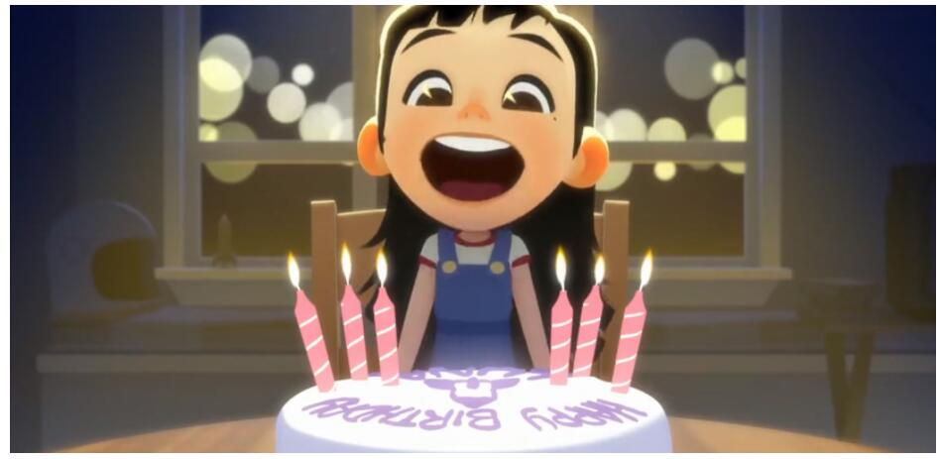
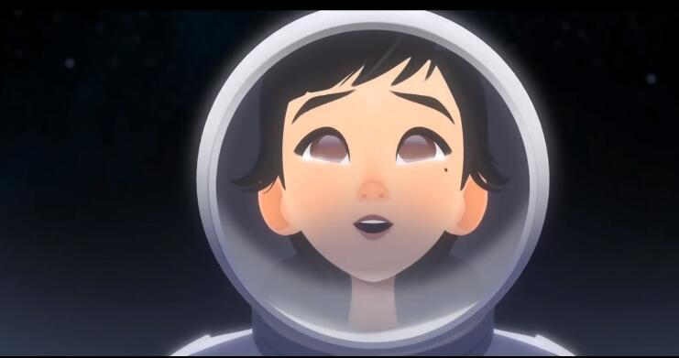
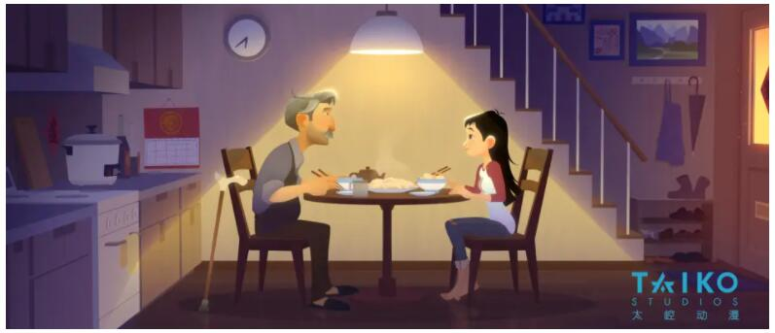
Lively Character Design
Disney Style
Storyboard - Plot fluctuation
Lively emotion and movement
Ambitious - Become an astronaut
Family Love

Slide 9
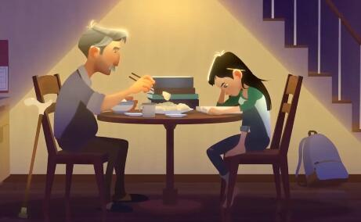
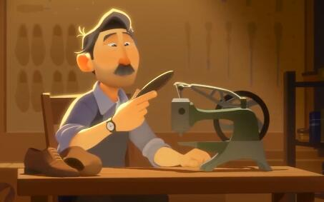
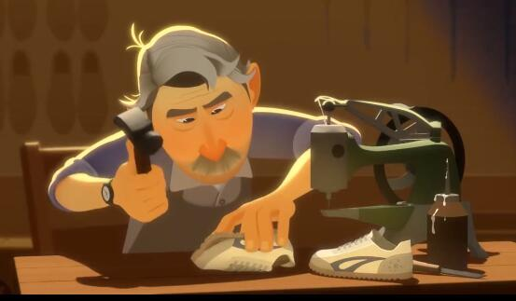
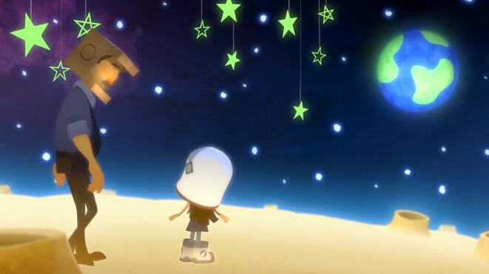
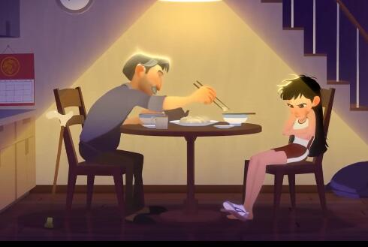
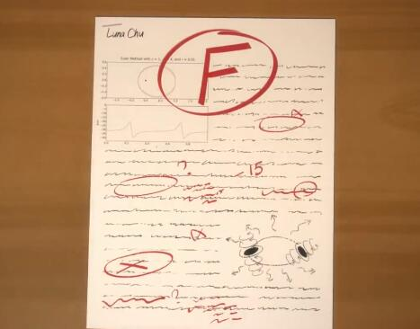
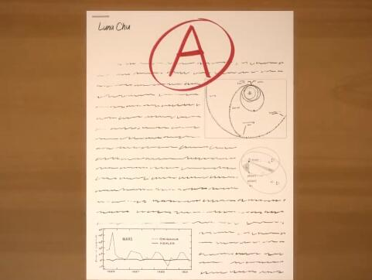
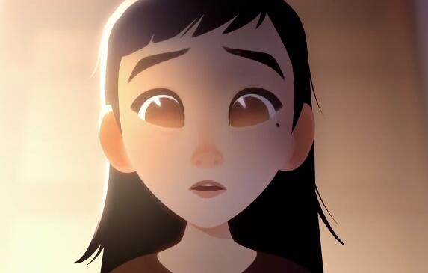
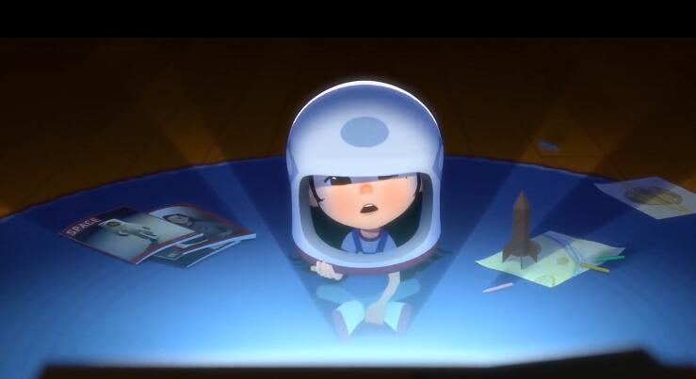
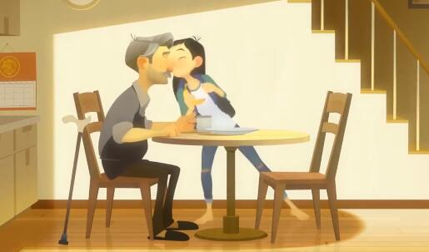
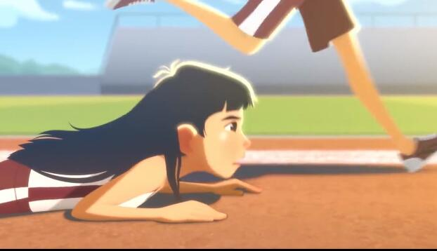
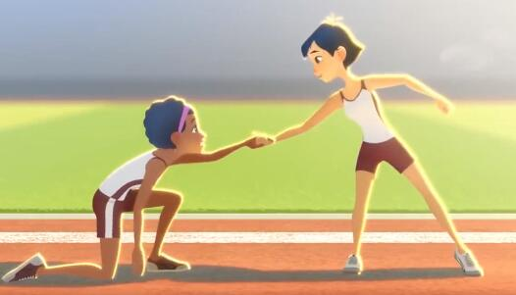
Film Language Analysis
Pudovkin Montage Theory (1998, I)
“Connect each shot well, so that the audience can finally feel that it is a complete, uninterrupted and continuous movement - this technique is often called montage” (Pudovkin, 1998)
Repeat Montage
Camera Work
Full Shot
Medium Shot
Close Up
High Angle

Slide 10
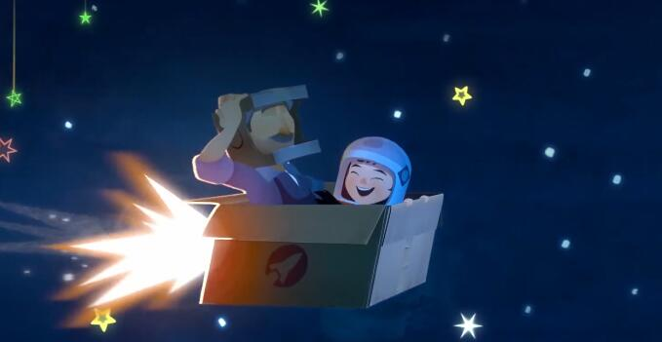
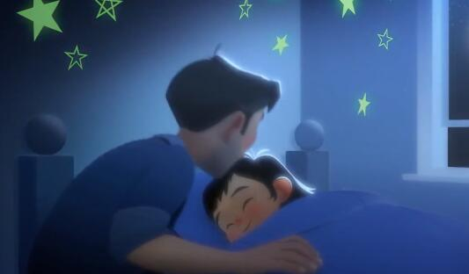
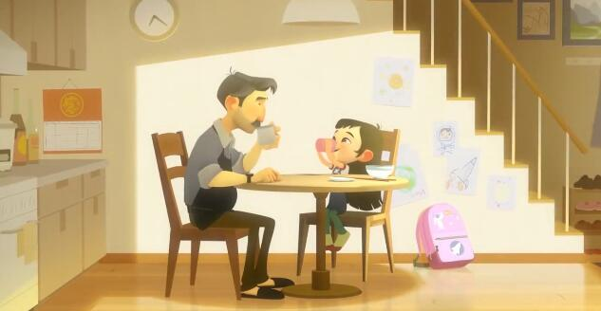
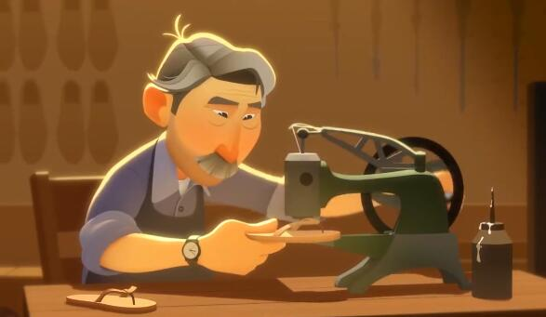
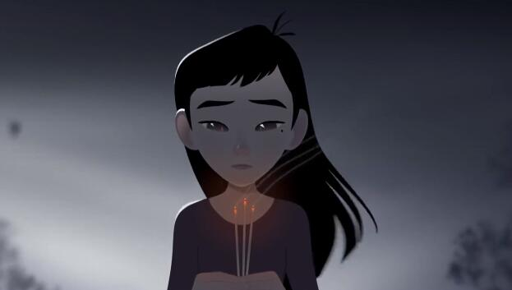
Color Effects
Sound Effects
·Steve Horner
·Different instrument
Cello (Father)
Bells (Luna)
·Different Ages of Luna
Child (Light)
Adult (Strong)
Blue Luna Dream
Orange Father Warm
https://youtu.be/NgesfBUmwxc
Grey Sad Feedback

Slide 11
3. The historical and political connections with his work
·One Small Step is the furthest time that Chinese animator have gone on the Oscar.
·Zhang Shaofu helps Wuhan person to build up their confidence.
·Zhang Shaofu believes that Chinese Animation will have their on style and go further.

Slide 12
4. What I have learned from him
·The story is very important in a successful animation.
·Major in animation needs a strong interest, then you are more likely to spend more time.
·Using film dialogue in animation will help the audience to understand the animation.

Slide 13
5. Sources
https://vimeo.com/405980039 (Introduction) https://vimeo.com/13273095 (Dragonboy)
https://youtu.be/HfbOLXa-rWE (Interview1) https://youtu.be/xBKtzg4yLqc (Interview2)
https://www.bilibili.com/video/BV1oW411j7ay?from=search&seid=1890290181104314431&spm_id_from=333.337.0.0
(Interview3)
https://www.bilibili.com/video/BV1TN411Z7pN?from=search&seid=7008664652616652479&spm_id_from=333.337.0.0
(The Performance)
Walker, M., Lin, G., Sawyer, J., (2012) An Annotated Corpus for Learning and Characterizing Character Style, Available at:
https://www.researchgate.net/publication/265947462_An_Annotated_Corpus_of_Film_Dialogue_for_Learning_and_Characterizing_Character_Style
(P. 1373-1378) Haiting, W., (2019) Chinese animation is “One Small Step”, Beijing, Radio and Television Commentary
Chong, Z., (2019) From Chinese Guanggu to Oscar Animation Enterprise, Beijing, Service Outsourcing

Slide 14
Thank you for watching！
Any questions?

